Slide 1
Generative Modeling
Exploratory Project (CSE-291)
By: 21075059- Neerudu Nikhil
21075069 - Ravi
21075100 - Vriddhi Shri
Guided By: Dr. Pratik Chattopadhyay

Slide 2
What is Generative Modeling
Why do we need Generative Modeling
Discriminative vs Generative Modeling
Multinomial Distribution
Naive Bayes Classification
Gaussian Naive Bayes
Gaussian Discriminant Analysis
Gaussian Mixture Models
Autoencoders
Variational Autoencoders
Generative Adversarial Networks
Deeply Convolutional Generative Adversarial Networks
Conditional Generative Adversarial Networks
Table of Contents

Slide 3
Generative Model
Generate new data samples that are similar to the original data on
which it was trained.
Model gives probabilistic estimation of new data instances.
Work by learning the underlying distribution of the data .
Easy to implement.
Useful in implementation of complex data.
Challenges :
To ensure that the generated data is realistic and high-quality.
May replicate the original data without introducing new variations.

Slide 4
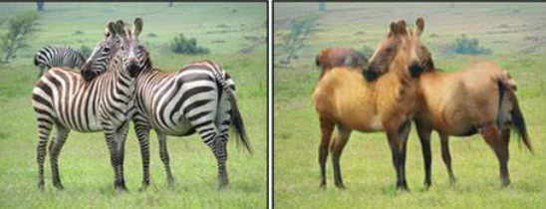
Need Of Generative Modelling
Generative model is Useful in wide applications such as:
Data Augmentation.
Simulation of Future and Planning.
Image Restoration.
Video generation.
To find Missing Data
Image Denoising.
In creativity and Art zebra horse
Text and Speech Processing source : medium.com

Slide 5
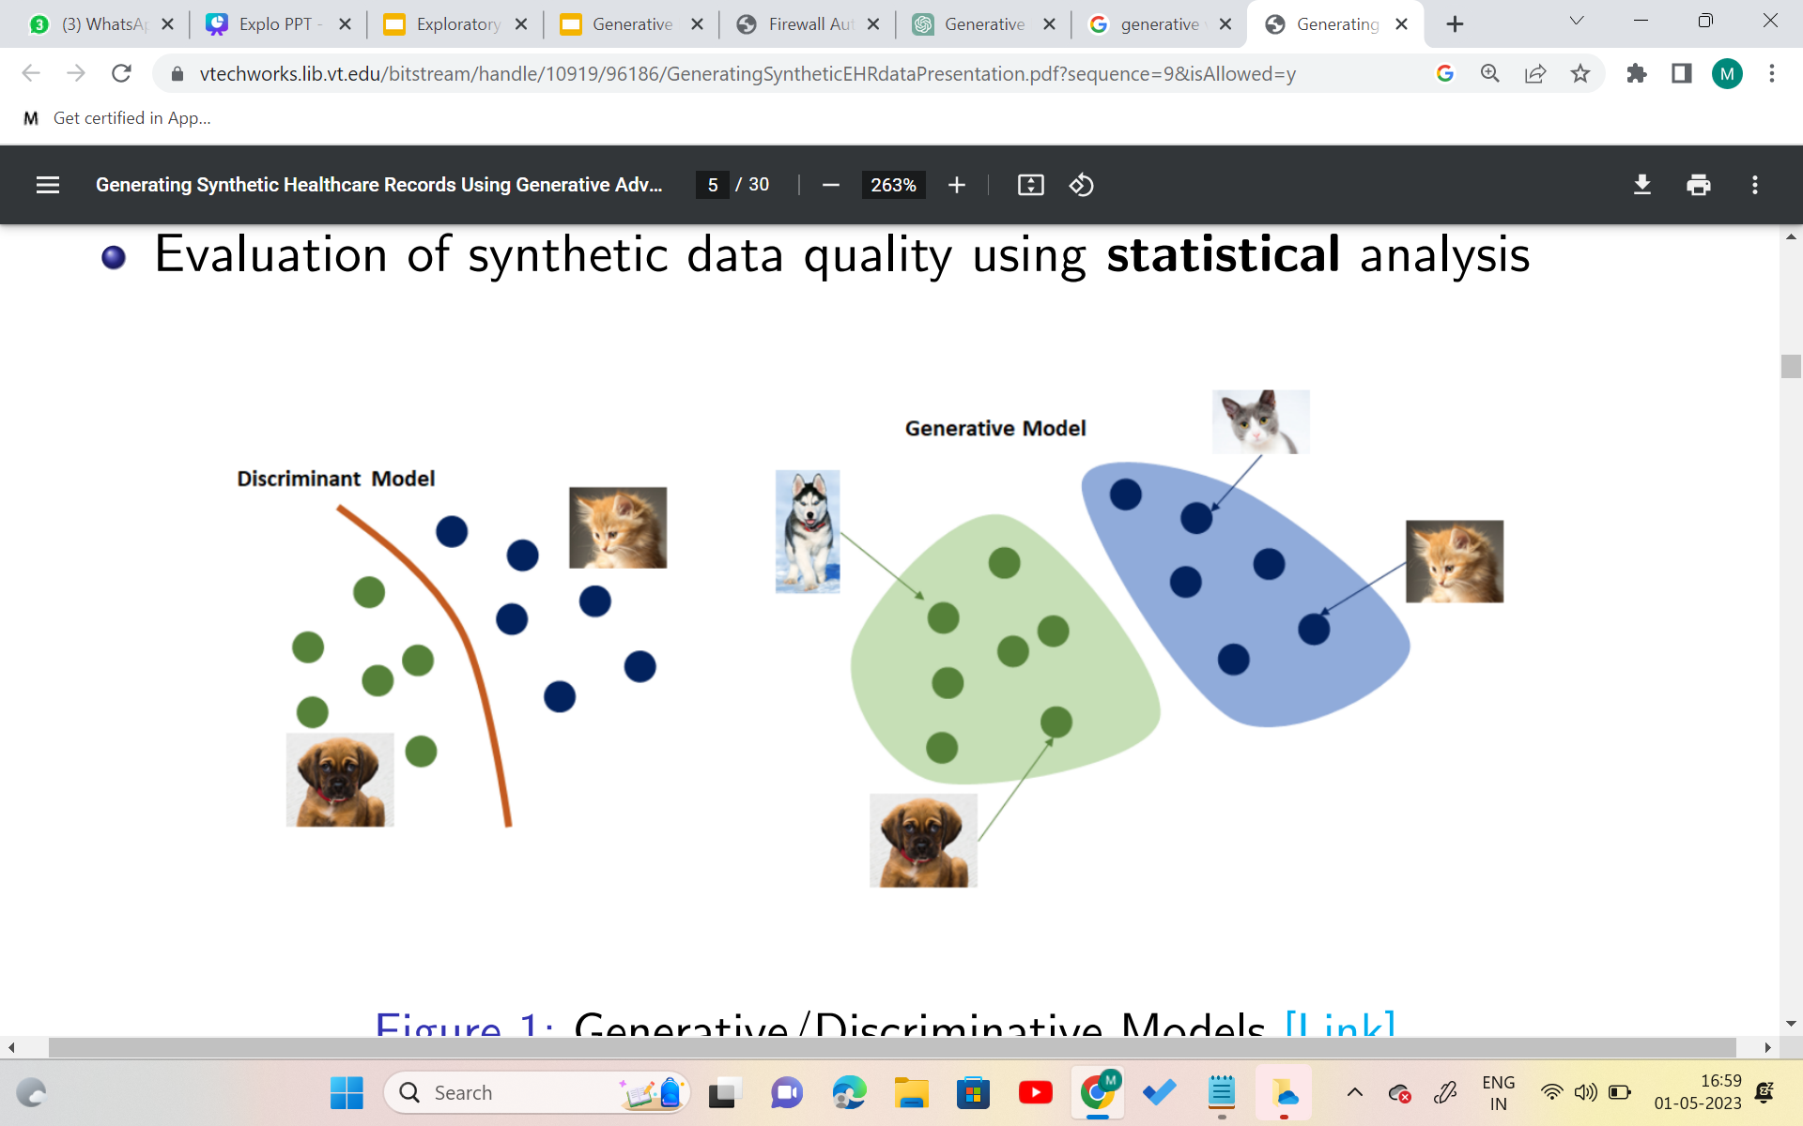
Generative Vs Discriminative model
Generative
Used to generate new data similar to original data.
Unsupervised form of learning.
Learns to estimate the probability of an observation X i.e P(X).
Require large and diverse training dataset
Computationally expensive for large datasets
Ex - Generate new pictures of cats.
Discriminative
Used to classify between different types of instances of data.
Supervised form of learning.
Model tries to estimate label Y for a given observable variable X i.e, P(Y | X).
Require only labeled data
Not as good at modeling data distribution.
Ex - Classify an animal as Cat.

Slide 6
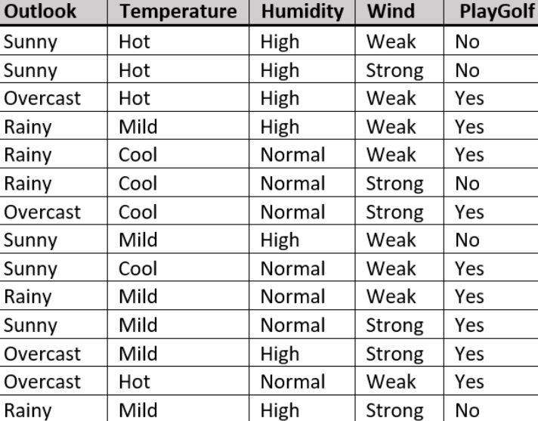
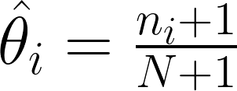
Multinomial Distribution
Dataset help in determining whether a particular weather condition is suitable ("Yes") or not("No") for playing golf.
Dataset has been generated by some distribution pdata (unknown).
The aim of the model is to use these observations to produce the pdata.
Total Number of Observations is 13.
Total 3 * 3 * 2 * 2 =36 possible combinations of features i.e 36 sample points
θi : parameter that represent probability of ith sample point. To estimate θi , i = 1 . . . 35, by MLE
ni : occurrence of ith observation
N : total number of observations
1 is additive factor for non-zero probability
Source : gfg.com
FAILURES :
Assign equal probability to all the random pixels not present in dataset
Remember the given data without learning anything new.

Slide 7
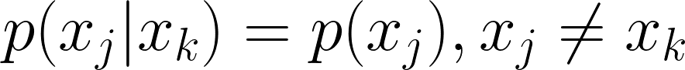
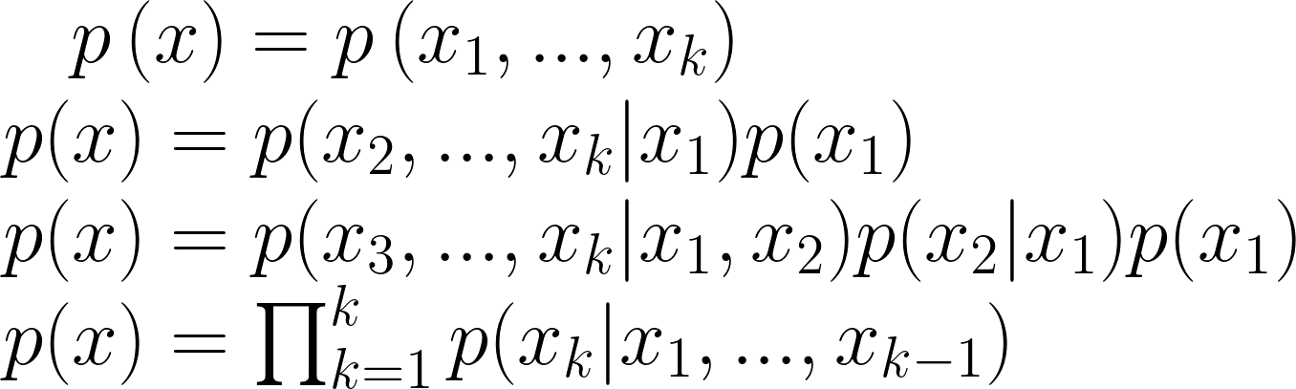
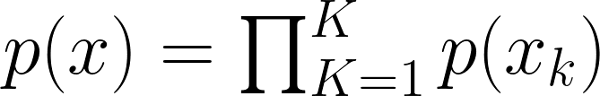
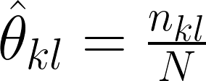
NAIVE BAYES
The Naive Bayes parametric model reduces the number of parameters we need
to estimate.
Assumptions : 1. Features are Independent of each other i.e,
2. Each Features has equal contribution in determining labels.
Where K is the total number of features.
Using assumption we get :
This is the Naive Bayes model.
The problem is reduced to estimating the parameters for each feature separately
Then multiplying these to find the probability for any possible combination.

Slide 8
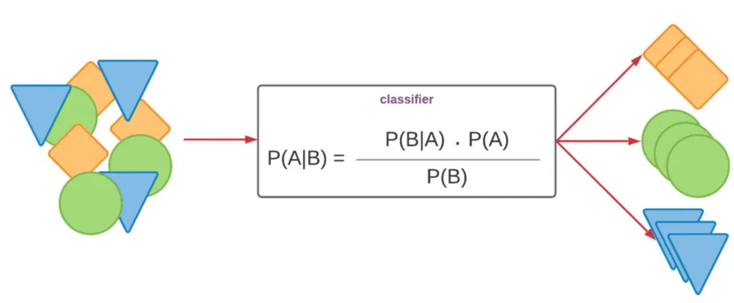
Application of Naive Bayes :
Sentiment Analysis
Spam Classification
Recommendation systems
Language Identification
Disadvantages :
Can only be applicable on Discrete features value .
Assigns zero probability to feature value not present in training set, which can affect the performance of the classifier.
Rarely applied to real life models, as it is designed to model on features that are independent of each other.

Slide 9
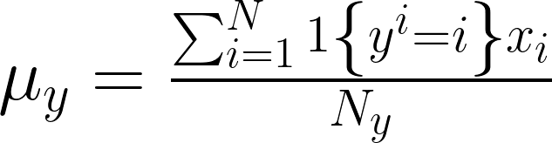
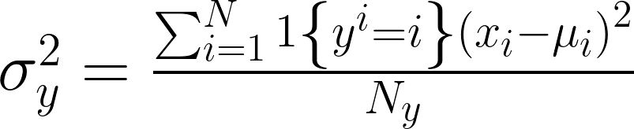
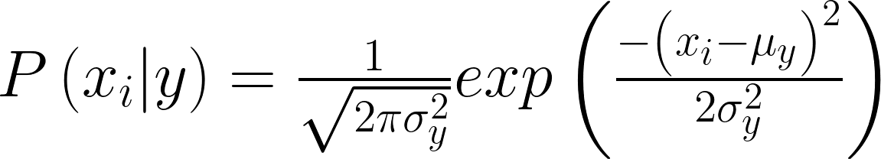
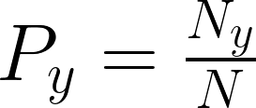
A variation of the Naive Bayes algorithm that works when :
- the features in the dataset are continuous.
Assumption: Distribution of each feature for each class is Gaussian (normal) with mean and variance :
.
Gaussian Naive Bayes
where Ny = number of occurances of class y in dataset
N = Total Number of data in the training data.

Slide 10
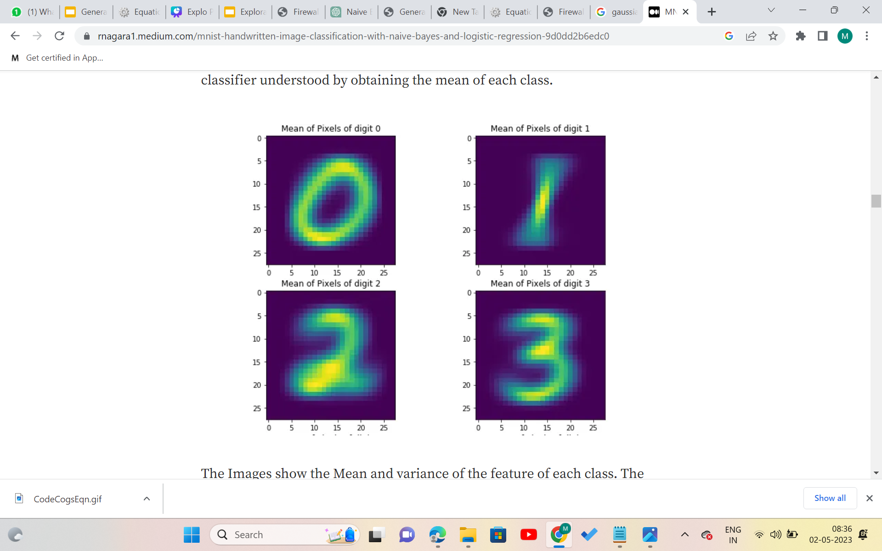
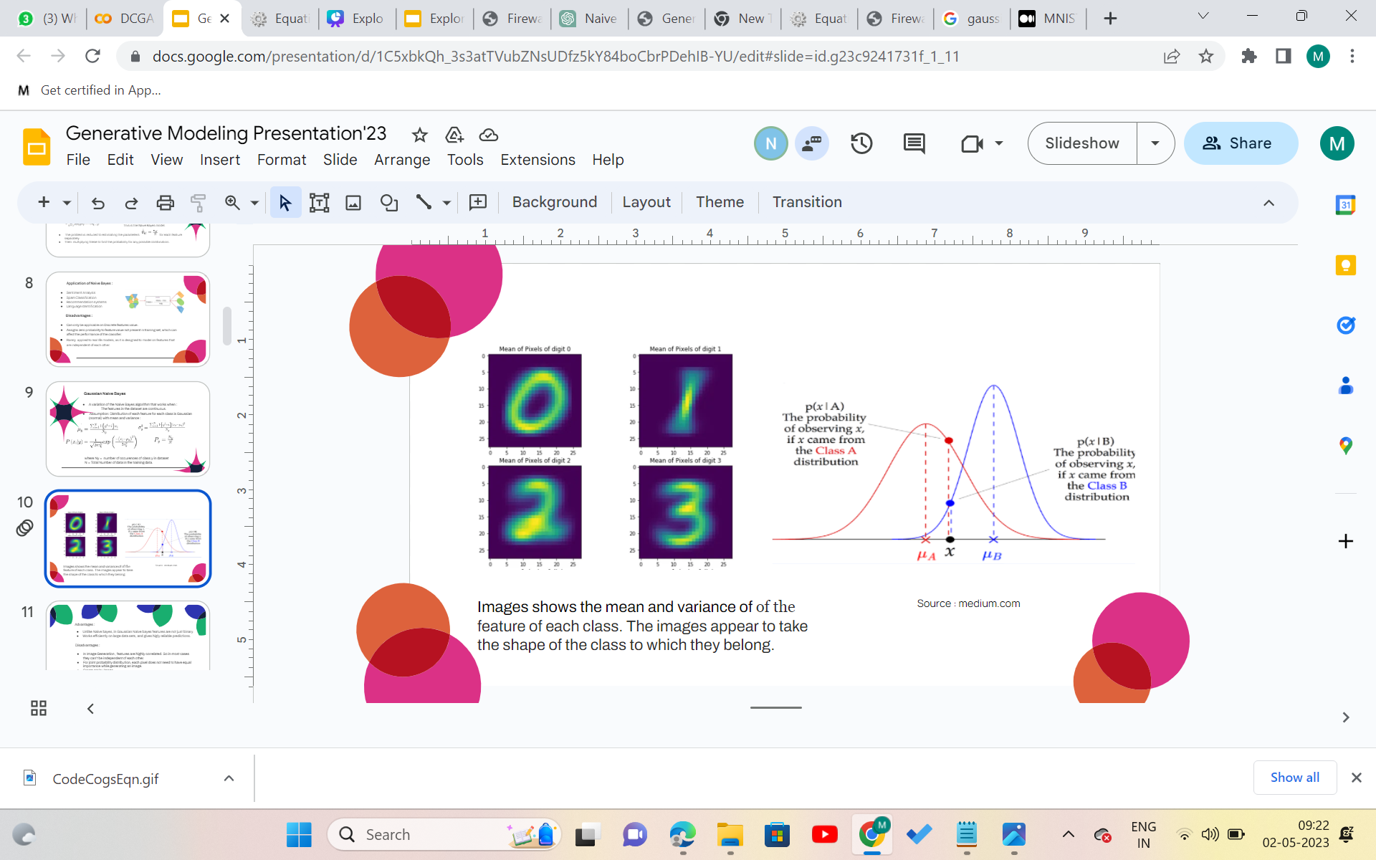
Images shows the mean and variance of of the feature of each class. The images appear to take the shape of the class to which they belong.
Source : medium.com

Slide 11
Advantages :
Unlike Naive bayes, in Gaussian Naive bayes features are not just binary.
Works efficiently on large data sets, and gives highly reliable predictions.
Disadvantages :
In Image Generation , features are highly correlated. So in most cases they can’t be independent of each other.
For joint probability distribution, each pixel does not need to have equal importance while generating an image.
Create Noisy image.

Slide 12
Gaussian Discriminant Analysis:
Gaussian discriminant analysis (GDA) is a classification algorithm that makes assumptions about the probability distribution of the features in each class.
Assumptions:
GDA assumes that the features in each class follow a multivariate normal (Gaussian) distribution
Covariance matrix of each class is assumed to be same, and the reason being that the decision boundary would be linear.

Slide 13
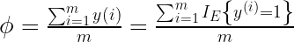
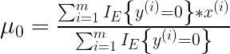
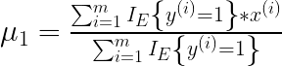
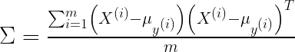
GAUSSIAN DISCRIMINANT ANALYSIS
Estimated Parameters using Maximum Likelihood:
GDA makes stronger set of assumptions so that model would fit better if X/y=0 and X/y=1 nearly follow Gaussian distribution.
Assumptions of Logistic regression could be achieved by considering the assumptions of GDA.
GDA is used only to avoid computational complexity and require only mean, variance and covariance computation.

Slide 14
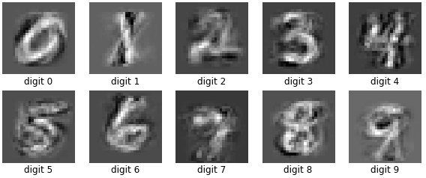
GAUSSIAN DISCRIMINANT ANALYSIS
Limitations:
Equal covariance matrix is assumed in this analysis which is not applicable to practical analysis.
For high dimensional dataset, this model is computationally expensive as it is needed to estimate the covariance matrix.
GDA struggles to classify infrequent classes in unbalanced datasets, as it tends to learn majority class effectively.

Slide 15
Mixture Models:
Types of Clustering Methods
Hard Clustering: Clusters do not overlap
element either belong to cluster or it does not
Soft Clustering : Clusters may overlap
strength of association between clusters and instances
Mixture Models
Probabilistically-grounded way of doing soft clustering
Each cluster is a generative model (Gaussian or multinomial)
parameters (e.g. mean/covariance are unknown)
Expectation Maximisation (EM) Algorithm
automatically discover all parameters for the K 'sources'.

Slide 16
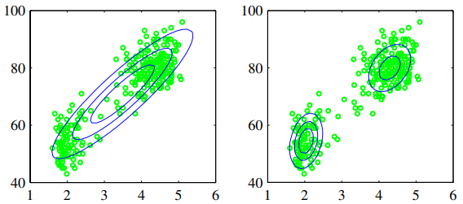
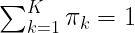
Gaussian Mixture Model:
A Gaussian Mixture is a function that is comprised of several Gaussians, each identified by k ∈ {1,…, K}, where K is the number of clusters of our dataset.
Each Gaussian k in the mixture is comprised of the following parameters:
A mean μ that defines its centre.
A covariance Σ that defines its width.
A mixing probability π that defines how big or small the Gaussian function will be.
The mixing coefficients must meet the following condition:
Clustering of the data points

Slide 17
EM Algorithm (Expectation Maximisation)
It is an iterative optimization technique that operate locally.
The EM algorithm consists of two main steps: E-step and the M-step.
E-step involves computing the posterior probabilities of the missing variables or latent variables, conditioned on the observed data and the current parameter estimates.
In the M-step, the algorithm updates the model parameters (computed in the E-step) to maximize the expected log-likelihood, subject to any constraints imposed by the model. .
This iterates between these two steps until convergence, that is, until the change in the log-likelihood between successive iterations falls below a certain threshold

Slide 18
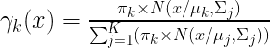
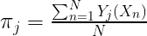
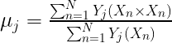
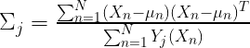
Expectation Maximisation for Gaussian Mixture Model:
Initialization of the parameters i.e mean vectors, covariance matrices and weights of Gaussian components.
E-step: Evaluating the responsibilities that it belongs to each gaussian component, using current GMM parameters.
M-step: Updating mean, covariance matrices and weights by maximizing the log-likelihood.
Repeating steps 2-3 until convergence criteria is reached.

Slide 19
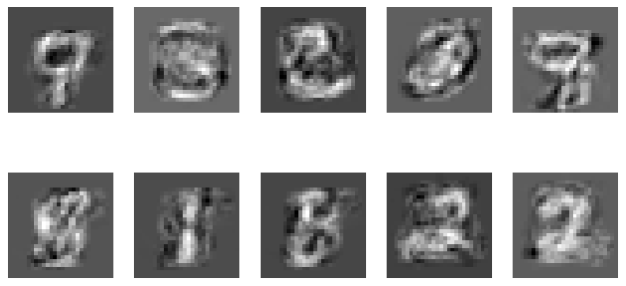
Mnist Digits generation from Gaussian Mixture Models
Advantages:
Capturing of complex non-linear relationships in the data provides GMM with improved clustering performance and noisy handling.
Probabilistic decision making of GMM makes it useful for risk management
Large datasets can be handled by variational inference and EM algorithms.

Slide 20
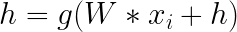
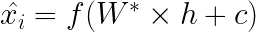
Autoencoders:
It is a special type of feed forward neural network which
- encodes its input xi into a hidden representation h.
- decodes the input again from this hidden representation.
Model will be trained to minimize a certain loss function which will ensure x_i^ is close to x_i.
If dim(hi)<dim(xi), and if it can reconstruct yi from h such h is known to be loss free encoding of xi, encoder is called under complete autoencoder.
If dim(hi)>dim(xi), such encoder lears the trivial encoding and it is known as overcomplete autoencoder.

Slide 21
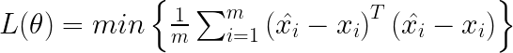
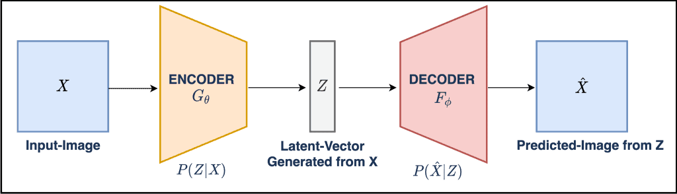
AUTOENCODERS
Loss Functions:
– For real inputs,
– For binary inputs cross entropy is minimised

Slide 22
AUTOENCODERS
Regularisation of Autoencoders:
Regularization refers to techniques that are used to calibrate machine learning models in order to minimize the adjusted loss function and prevent overfitting or underfitting.
For regularisation , the simplest solution is to add L2 regularisation term to the function.
Parameters of the encoder and decoder are reduced by considering

Slide 23
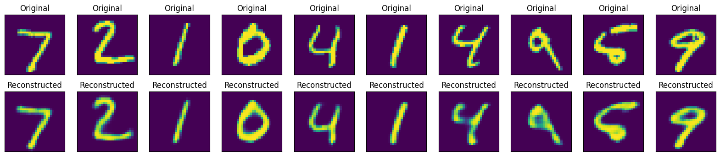
AUTOENCODERS
Reconstruction of MNIST digits using an autoencoder
Limitations:
Autoencoders overfit the input data, by memorising the input rather than learning the features.
Latent space of autoencoder is discontinuous.
If input data is complex, then training the autoencoder is computationally expensive.

Slide 24
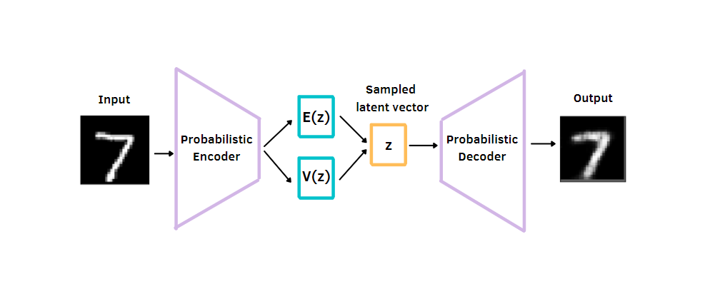
Variational Autoencoder:
Variational autoencoder describes an observation in latent space in a probabilistic manner, which brings continuity for the latent space which is the major limitation of an autoencoder.
When decoding from the latent state, we'll randomly sample from each latent state distribution to generate a vector as input for our decoder model.
Actual encoding is calculated by sampling from Gaussian with that Mean and Variance it varies somewhat during each pass.
Block diagram representing Variational Autoencoder

Slide 25
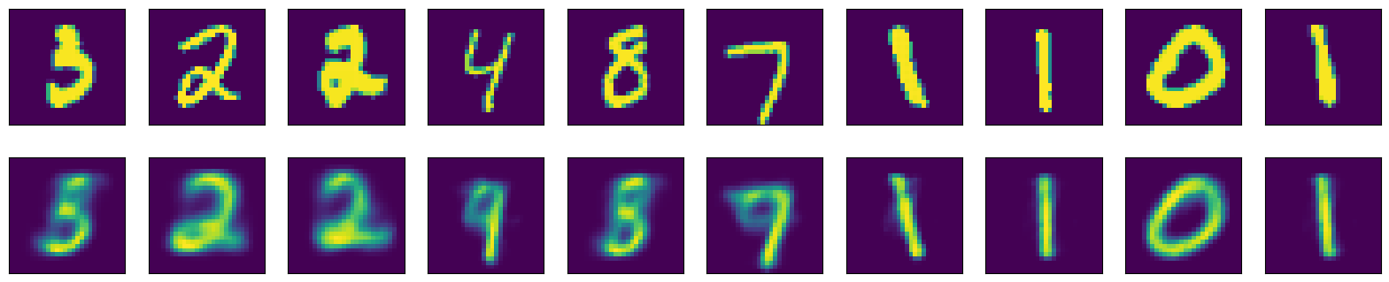
For symmetrical distributed encoding, encoder is forced to fit gaussian normal distribution with the mean and variance in latent space.
KL Divergence loss of encoder is minimised with the standard normal distribution ensuring it to be concentrated at origin.
KL Divergence loss:
MNIST digit images generated by variational autoencoder

Slide 26
Generative Adversarial Network (GAN)
Generative Adversarial Networks (GANs) were developed in 2014 by Ian Goodfellow and his teammates.
To understand the term GAN let’s break it into separate three parts -
Generative - To learn a generative model, which describes how data is generated in terms of a probabilistic model. In simple words, it explains how data is generated visually.
Adversarial - The training of the model is done in an adversarial setting.
Networks - use deep neural networks for training purposes.

Slide 27
Generative Adversarial Network (GAN)
The GAN model architecture includes two sub-models :
Generator - generate data that is fake data based on original(real) data.
Discriminator - predicts data is fake or real.
The generator generates a batch of samples, and these, along with real examples from the domain, are provided to the discriminator and classified as real or fake.
The discriminator is then updated to get better at discriminating real and fake samples in the next round
The generator is updated based on how well, or not, the generated samples fooled the discriminator.

Slide 28
Generative Adversarial Network (GAN)
Training the Generator:
The generator takes random noise as its input.
It produces generator output from sampled random noise.
It gets discriminator "Real" or "Fake" classification for generator output.
Loss is calculated according to classification by discriminator.
Backpropagate through both the discriminator and generator to obtain gradients.
Gradients are used to change only the generator weights.

Slide 29
Generative Adversarial Network (GAN)
Training the Discriminator:
The discriminator is fed by the real data instances from the training data and fake data instances created by the generator.
It gives a ‘Real’ or ‘Fake’ classification for the generated image.
The discriminator is penalized by the discriminator loss for misclassifying a real instance as fake or a fake instance as real.
The discriminator updates its weights through backpropagation from the discriminator loss through the discriminator network.

Slide 30
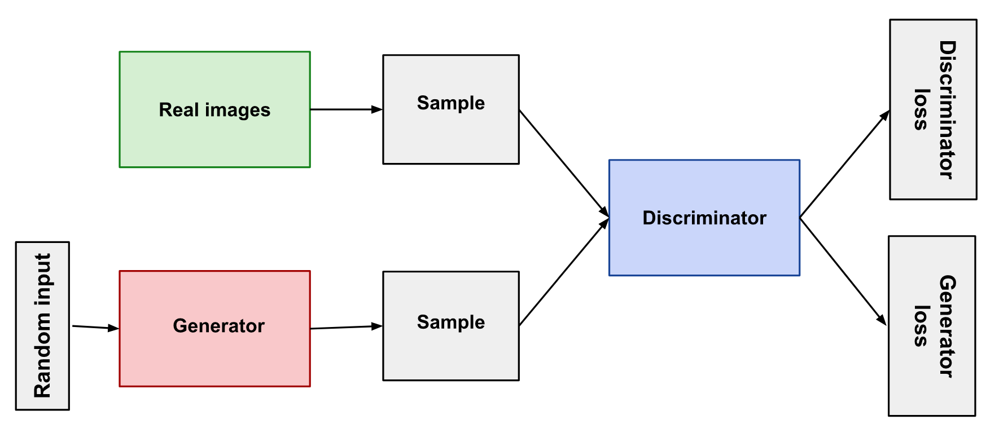
Generative Adversarial Network (GAN)
Schematic Diagram of a Generative Adversarial Network

Slide 31
Generative Adversarial Network (GAN)
Define a Problem
Train Discriminator on Real Data
Train Discriminator on the fake data
1
3
5
2
4
6
Select Architecture of GAN
Generate fake inputs for Generators
Train Generator with the output of Discriminator
Training of GAN

Slide 32
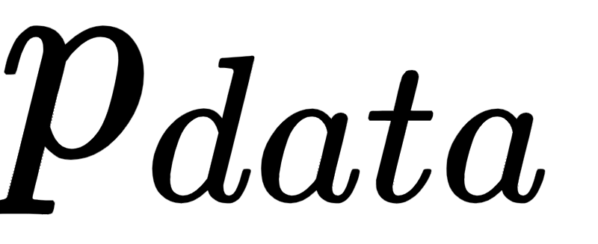
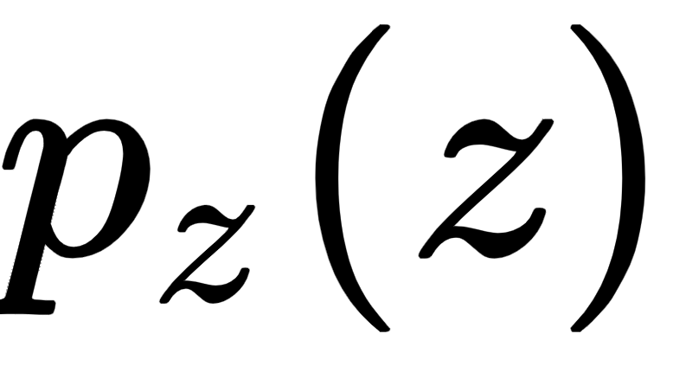
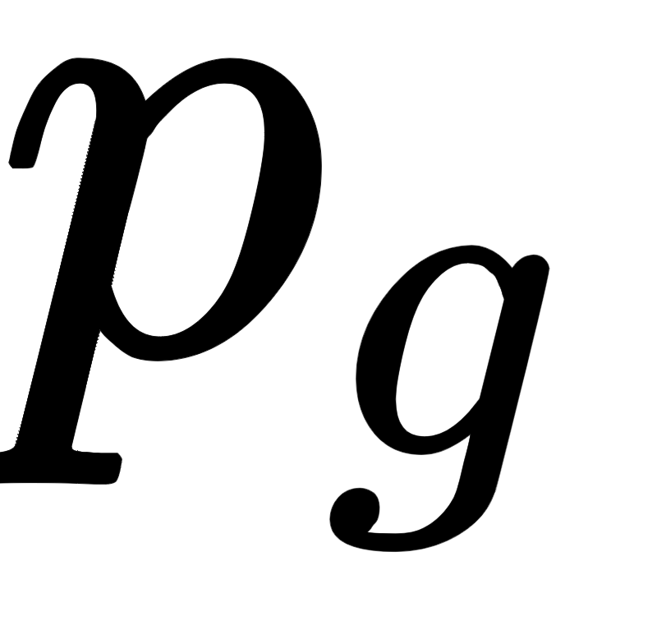
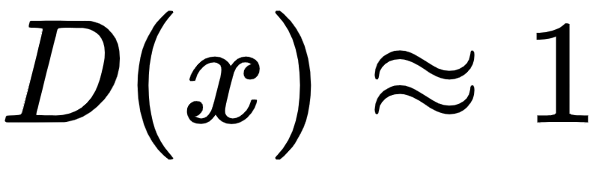
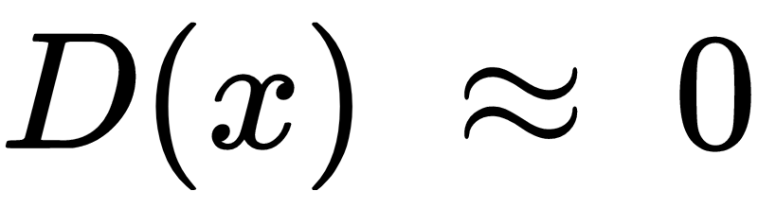
Generative Adversarial Network (GAN)
Training data: generated from some unknown distribution
Generator samples from known distribution and maps it to image function according to function G.
If G(z) has probability distribution function , we want to approximate by
Discriminator: samples from and and classifies it as real ( ) / fake ( )
Two neural networks D and G play min-max game.
Discriminator: maximises V(D, G).
Generator: minimises V(D, G).

Slide 33
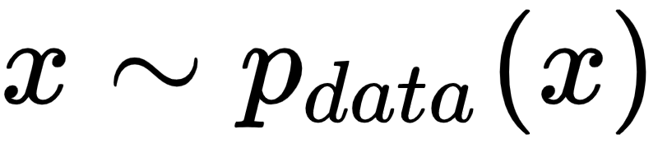
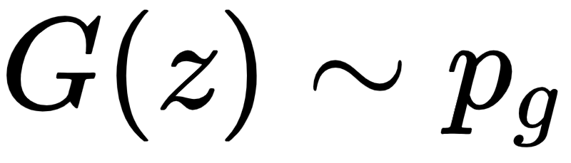
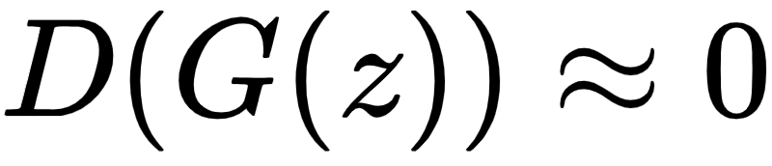
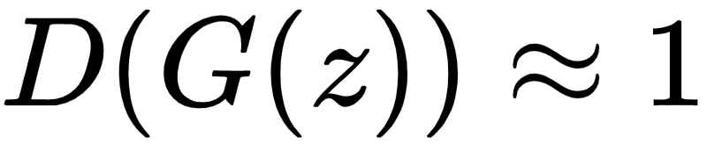
Generative Adversarial Network (GAN)
Loss Function :
Real Image ( ): Discriminator wants , so first term is maximum.
Fake image ( ): Discriminator wants ,so 2nd term is maximum.
Generator wants to fool the discriminator into predicting the fake image as real i.e.
hence it wants to minimize second term.

Slide 34
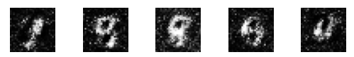
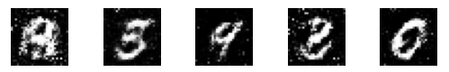
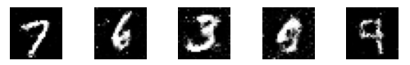
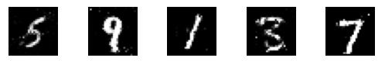
Generative Adversarial Network (GAN)
MINIST Images after 2000 epochs
MINIST Images after 5000 epochs
MINIST Images after 14000 epochs
MINIST Images after 20000 epochs

Slide 35
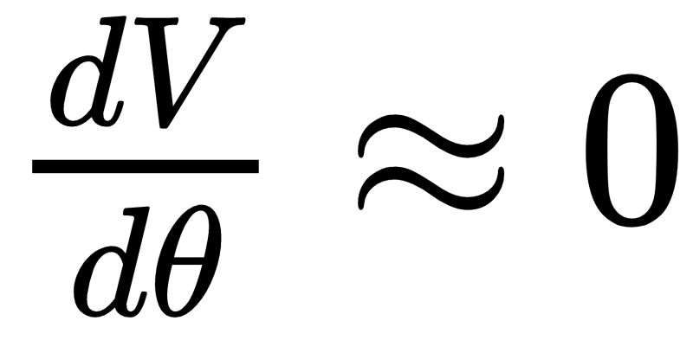
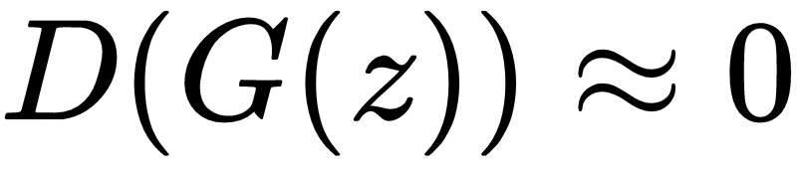



Generative Adversarial Network (GAN)
Major Shortcomings :
Mode Collapse - During training, the generator may get stuck into a setting where it always produces the same output. This is called mode collapse. This happens because the main aim of G was to fool D not to generate diverse output.
Vanishing Gradients - Initially, when where represents weight of generator. To overcome this instead of minimising we maximise

Slide 36
Deeply Convolutional GAN
DCGAN uses convolutional and convolutional-transpose layers in the generator and discriminator, respectively.
Replace any pooling layers with strided convolutions (discriminator) and fractional-strided convolutions (generator).
Here the discriminator consists of strided convolution layers, batch normalization layers, and LeakyRelu as activation function.
The generator consists of convolutional-transpose layers, batch normalization layers, and ReLU activations(except in last layer which uses tanh).
Remove fully connected hidden layers for deeper architectures.

Slide 37

Deeply Convolutional GAN
Discriminator and Generator architecture of a typical DCGAN

Slide 38

Deeply Convolutional GAN
MNIST like Digits generated using DCGANs
MNIST digits generated using DCGAN

Slide 39

Deeply Convolutional GAN
DCGAN Implementation on CelebA Dataset

Slide 40
Conditional Generative Adversarial Networks
Conditional GAN (cGAN) allows us to condition the network with additional information such as class labels.
It means that during the training, we pass images to the network with their actual labels for it to learn the difference between them.
That way, we gain the ability to ask our model to generate images of specific labels.
The generator then tries to generate the image having that class label.
Discriminator has to decide whether the image is real belonging to the same class as class label.

Slide 41

Conditional Generative Adversarial Networks
Schematic Diagram of Conditional GAN

Slide 42
Conditional Generative Adversarial Networks
Improved control over generated outputs.
cGANs are less likely to suffer from mode collapse as the conditional information can help guide the generator towards a more diverse set of outputs.
Shortcomings -
cGANs are more complex than traditional GANs due to the need to include additional input information, which can make them harder to train and tune.
If the conditioning information is incomplete or inaccurate, the generated output may also be inaccurate.

Slide 43

Conditional Generative Adversarial Networks
MNIST digits generated using CGAN

Slide 44

Conditional Generative Adversarial Networks
Implementation of CGAN on CIFAR10 Dataset

Slide 45
Thank you!

